Slide 1




Exercise Pose Tracker
Chavali Vallabha Makarand K Rishith Pranav
CB.EN.U4CSE21215 CB.EN.U4CSE21232
K Sri Sai Adarsh Y G Ram Darshan Reddy CB.EN.U4CSE21233 CB.EN.U4CSE21269
Github URL:https://github.com/6302606344/Exercise-tracker-
Track your fitness journey by observing
count and setting achievable goals.
Professor:
Dr.T Senthil Kumar(CSE)

Slide 2
General Guidelines for the sections of the paper
Please find the PDF document in the below link.
General Guidelines for paper writing.pdf

Slide 3
Agenda
Introduction
Literature survey
Challenges
Dataset description
Methodology
Data analysis
ML model
DL model
Explainable AI
Conclusion
Future Enhancement

Slide 4
Contributions
Roll.No | Name | Contribution | Uniqueness in Contribution
CB.EN.U4CSE21215 | Chavali Vallabha Makarand
CB.EN.U4CSE21232 | K Rishith Pranav
CB.EN.U4CSE21233 | K Sri Sai Adarsh
CB.EN.U4CSE21269 | Y G Ram Darshan Reddy

Slide 5
Introduction
The Exercise Pose Tracker is a cutting-edge fitness platform designed to revolutionize the way we approach workouts.
Leveraging AI-driven real-time assessments, this system provides instant feedback to users, ensuring that each exercise is performed with precision and accuracy.
By integrating gamification elements, it transforms routine exercises into engaging and motivating activities, encouraging users to surpass their fitness goals.
Statistical Inference
Recent studies indicate that improper exercise techniques can lead to a high incidence of injuries, with reports showing that up to 60% of gym-goers experience exercise-related injuries annually.
Furthermore, accurate form and consistency in exercises are crucial for maximizing the effectiveness of workouts.
The Exercise Pose Tracker addresses these issues by providing real-time corrections and feedback, which can potentially reduce the risk of injuries by 30-40% and improve overall workout efficiency by 20-25%.

Slide 6
Social Relevance
In an era where health and fitness are paramount, the Exercise Pose Tracker plays a significant role in promoting a healthier lifestyle.
By ensuring correct exercise techniques, it helps prevent injuries and fosters a safer workout environment.
The user friendly experience aspect keeps users motivated and engaged, which is particularly beneficial in combating sedentary lifestyles and encouraging regular physical activity.
This project not only enhances individual well-being but also contributes to broader public health goals by promoting active and healthy living habits.

Slide 7
Proposed Architectures:
Proposed framework will utilize the following architectures for different tasks:
Architecture Name for Joint Detection: CNN - Convolutional Neural Networks (CNNs) are used for detecting joints in exercise poses.
Architecture Name for Feature Extraction: RNNRecurrent Neural Networks (RNNs) are employed to extract sequential features from the detected joints, leveraging their ability to process temporal information.
Architecture Name for Pose Classification: DenseNet - Dense Convolutional Networks (DenseNet) are utilized for classifying the detected poses into specific exercise categories, benefiting from their dense connections for improved gradient flow and feature reuse.
Architecture Name for Temporal Analysis: GoogLeNet/Inception - GoogLeNet/Inception is used for analyzing the temporal dynamics of the exercise sequences, capturing the movement patterns over time with its inception modules.

Slide 8
Evaluation Metrics:
Precision
Recall
F1-score
Accuracy
Mean Squared Error (MSE)
Mean Absolute Error (MAE)
Area Under the ROC Curve (AUC-ROC)
Confusion Matrix
Specificity
Sensitivity
Intersection over Union (IoU) for localization tasks
Latency (for real-time performance)
Computational Complexity (FLOPs)
Model Size (number of parameters)
This comprehensive set of evaluation metrics ensures a thorough assessment of the models' performance across different aspects, from accuracy and error rates to computational efficiency and real-time applicability.

Slide 9
Problem Statement :
Exercise Pose Detection Using Computer Vision And Deep Learning
The Exercise Pose Tracker is a state-of-the-art fitness platform designed to revolutionize workout routines by leveraging computer vision and deep learning technologies.
This innovative system provides real-time feedback on exercise performance, ensuring that each movement is executed with precision and accuracy.
By detecting and analyzing exercise poses, it helps users maintain correct form, thereby reducing the risk of injury and enhancing the overall effectiveness of their workouts.
The platform utilizes advanced computer vision algorithms to capture and interpret body movements, while deep learning models evaluate these movements against ideal exercise forms.
If the exercise is performed correctly, it is counted and rewarded through a gamification system that keeps users motivated and engaged.
Incorrect poses trigger immediate feedback, guiding users to adjust their form for optimal results.

Slide 10
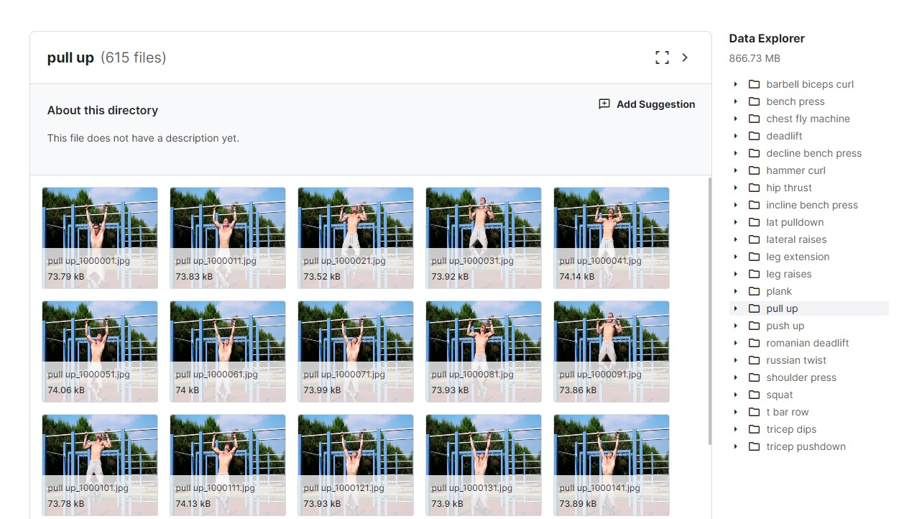
Dataset
Benchmark Dataset
Link:
https://www.kaggle.com/datasets/hasyimabdillah/workoutexercises-images?resource=download&select=pull+up

Slide 11
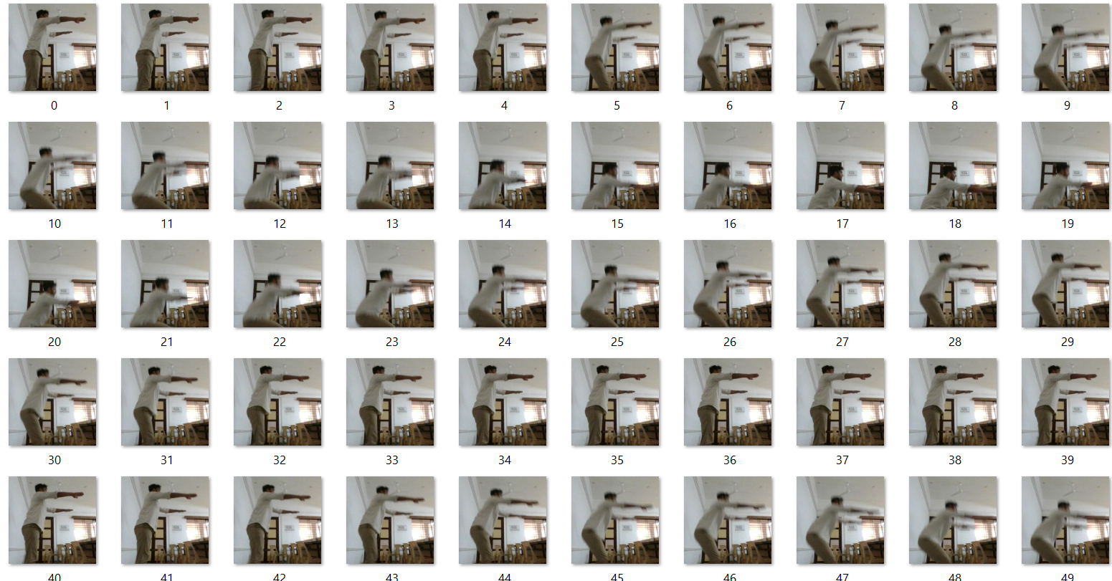
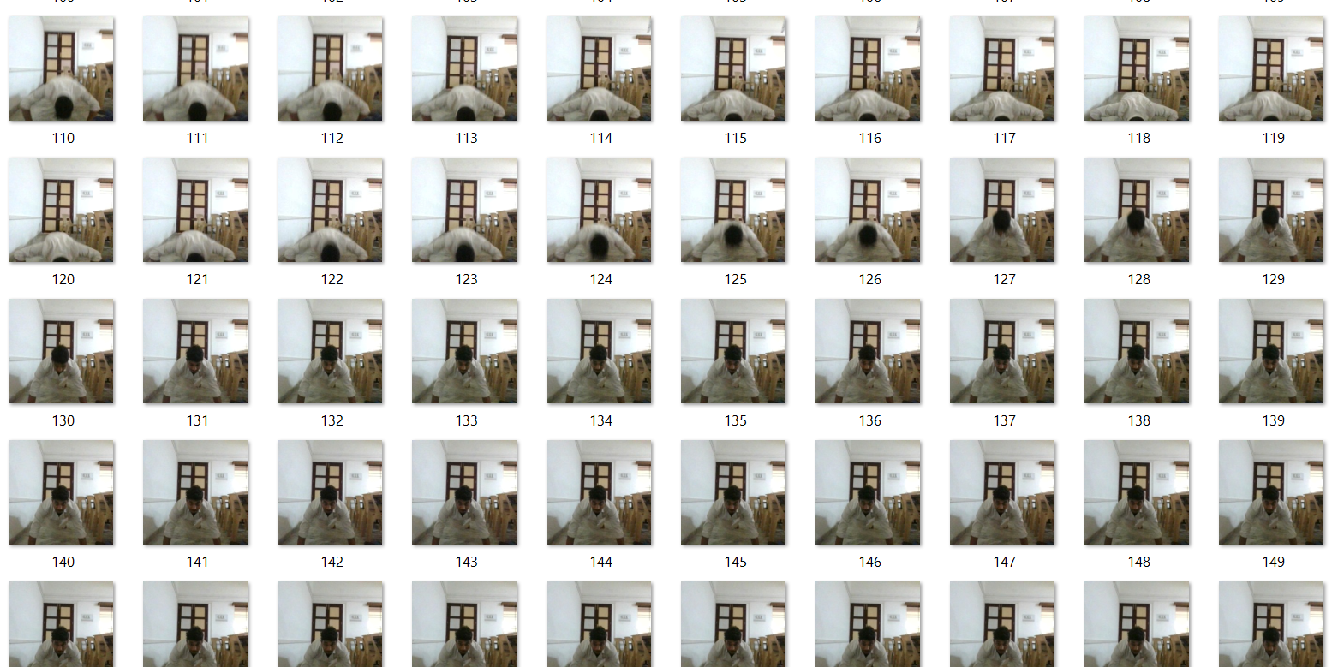
Customized Dataset:

Slide 12
Analytical Questions:
How can the system adapt to individual patterns and preferences?(M)
How can the system handle changes in the background environment? (M)
How can the system keep track of exercise count?(S)
If many people are in the frame, who should be tracked?(D)
How can the system distinguish between different exercises?(S)
How can the system ensure the accuracy of pose detection across various body types and fitness levels?(D)

Slide 13
Predictive Questions:
How many sets of exercise can he/she do in a session?(S)
What is the amount of stress he/she feels after a session?(S)
How much time does it take for the person to feel comfortable with that exercise?(M)
Can the system predict if the user is likely to maintain correct form throughout the exercise session?(M)
Can the system predict when to provide corrective feedback during an exercise to prevent improper form?(D)
Can the system predict the user's progress over time based on previous sessions?(D)

Slide 14
Research Questions:

Slide 15
Deep Learning with Computer Vision :
CNN
ResNet
EfficientNet
RNN
LSTM
Convolutional Neural Networks (CNNs), such as ResNet and EfficientNet, are utilized to process and analyze visual input from cameras, enabling accurate recognition and classification of different exercises. These architectures ensure precise counting and tracking of movements. To handle temporal data and understand the sequence and timing of exercises, Recurrent Neural Networks (RNNs) and Long Short-Term Memory (LSTM) networks are employed. These models track the progression of exercise performance over time and predict user adjustments in form, facilitating dynamic and responsive feedback.

Slide 16
Research Papers:
A Dataset and Evaluation Methodology for Template-based Tracking Algorithms - Sebastian Lieberknecht, Selim Benhimane, Peter Meier, Nassir Navab
Evaluation of Multiple Cues Head Pose Tracking Algorithms in Indoor Environments - Sileye O. Ba, Jean-Marc Odobez
Real-Time Human Pose Tracking from Range Data - Varun Ganapathi, Christian Plagemann, Daphne Koller, Sebastian Thrun
Joint Albedo Estimation and Pose Tracking from Video - Sima Taheri, Aswin C. Sankaranarayanan, Rama Chellappa
Verification of Reliability and Validity of Motion Analysis Systems during Bilateral Squat using Human Pose Tracking Algorithm - Megumi Ota, Hiroshige Tateuchi, Takaya Hashiguchi, Takehiro Kato, Yasuhiro Ogino, Momoko Yamagata, Noriaki Ichihashi

Slide 17
Research Gaps:
Benchmark Datasets for Template-based Tracking: - Lack of benchmark datasets for fair comparison of template-based tracking algorithms. - Need for real scene image sequences with precise and accurate ground truth poses.
Comprehensive Evaluation Schemes: - Absence of evaluation schemes that consider critical tracking parameters such as texture richness, camera motion, object scale, and lighting conditions.
Database for Head Pose Estimation: - Requirement for extensive databases with annotated head poses for better training and evaluation. - Enhancement needed in coupling tracking and head pose estimation algorithms.
Real-time Human Pose Tracking with Depth Data: - Improvement needed in handling unusual human poses and enhancing computational efficiency. - Extension of articulated ICP algorithms to effectively enforce constraints.
Joint Albedo Estimation and Pose Tracking: - Challenges in single image-based albedo estimation due to shadows and non-Lambertian effects. - Exploration of advanced filtering techniques for simultaneous pose tracking and albedo updating.
Reliability and Validity of Motion Analysis Systems: - Need to confirm the test-retest reliability and validity of OpenPose-based motion analysis. - Identification and correction of fixed and proportional biases for clinical utility.

